Slide 1
Machine Learning Basics on Linear Factor Models 3. Generalized Linear Models and Regression Trees
This slide set is largely based on Gu, Kelly, and Xiu (2020) and its Internet Appendix.

Slide 2

Objective
We aim to capture nonlinearities interactions among predictors in the expected return function.
Restricting the functional form of the model to be linear introduces approximation error due to model misspecification.
We show nonparametric models of $g(∙)$ with increasing degrees of flexibility.

Slide 3
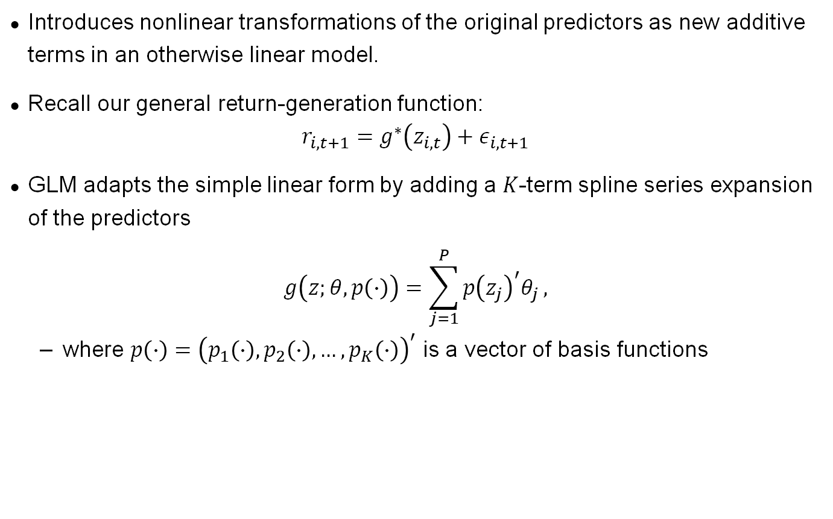
Generalized Linear Models
Introduces nonlinear transformations of the original predictors as new additive terms in an otherwise linear model.
Recall our general return-generation function:
$$r_{i,t+1}=g^{∗}\left(z_{i,t}\right)+ε_{i,t+1}$$
GLM adapts the simple linear form by adding a $K$-term spline series expansion of the predictors
$$g\left(z;θ,p\left(∙\right)\right)=\sum_{j=1}^{P}{p{\left(z_{j}\right)}^{′}θ_{j}},$$
where $p\left(∙\right)={\left(p_{1}\left(∙\right),p_{2}\left(∙\right),…,p_{K}\left(∙\right)\right)}^{′}$ is a vector of basis functions

Slide 4
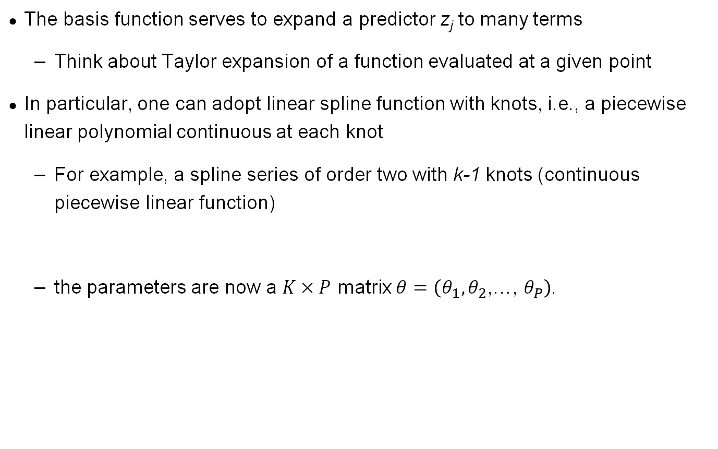
Generalized Linear Models
The basis function serves to expand a predictor z_{j} to many terms
Think about Taylor expansion of a function evaluated at a given point
In particular, one can adopt linear spline function with knots, i.e., a piecewise linear polynomial continuous at each knot
For example, a spline series of order two with k-1 knots (continuous piecewise linear function)
the parameters are now a $K×P$ matrix $θ=\left(θ_{1},θ_{2}\text{,…,} θ_{P}\right)$.

Slide 5
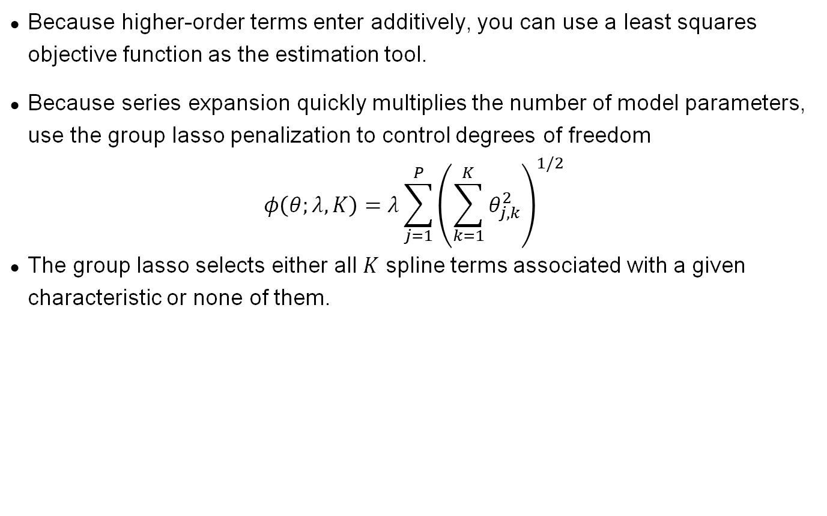
Generalized Linear Models
Because higher-order terms enter additively, you can use a least squares objective function as the estimation tool.
Because series expansion quickly multiplies the number of model parameters, use the group lasso penalization to control degrees of freedom
$$φ\left(θ;λ,K\right)=λ\sum_{j=1}^{P}{{\left(\sum_{k=1}^{K}{θ_{j,k}^{2}}\right)}^{1/2}}$$
The group lasso selects either all $K$ spline terms associated with a given characteristic or none of them.

Slide 6
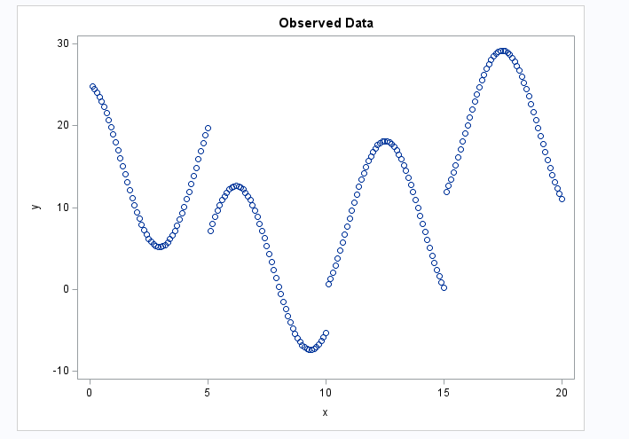
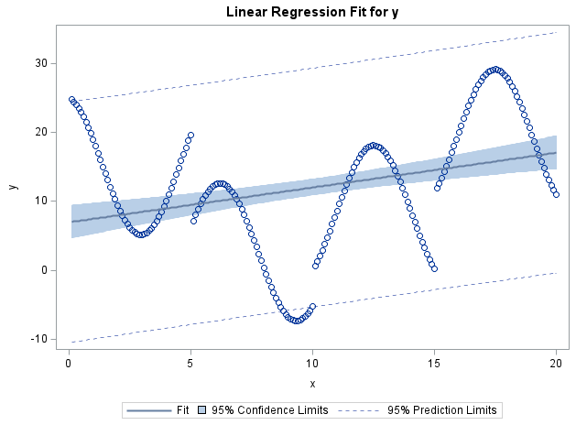
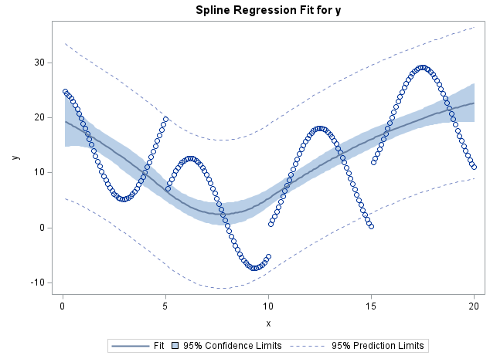
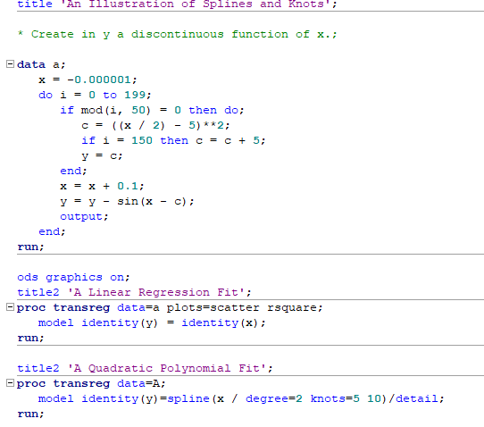
Example: Quadratic spline with two knots
Two knots set at 5 and 10.
5 (=1 + 2*2) parameters as I did not suppress an overall intercept.

Slide 7
Variable interaction in Generalized Linear Models
GLM Cons = it does not account for interaction among predictors, only captures individual predictors’ nonlinear impact on expected returns.
We can add interactions to the generalized model by including multivariate functions of predictors
However this can increase the parameterization combinatorially
Without a priori guidelines for which interactions to include, the generalized linear model becomes computationally infeasible

Slide 8
Regression Trees
An alternative approach for incorporating multiway predictor interactions.
Trees are fully nonparametric and possess a logic that departs from traditional regressions.
We focus on recursive binary regression trees for their relative simplicity, see Breiman et al. (1984) called Classification And Regression Trees (CART).
This link provides a good intuition of Regression trees in CART: https://uc-r.github.io/regression_trees

Slide 9
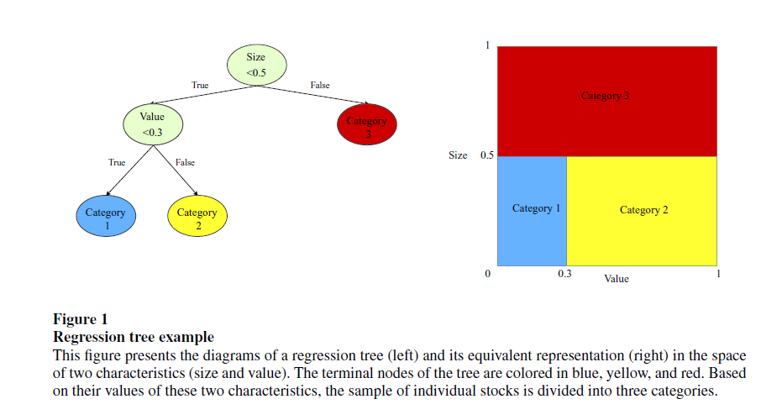
A starting example
This tree has 3 “leaves” (terminal nodes or partitions, K), 2 layers of depth (L), and 4 “branches” (C) (the number of branches equals the number of nodes minus one)

Slide 10
Tree outcomes
Given a tree and the estimated parameters, predictions with z predictors can be written as
where is one of the K partitions of the data. is simply the sample average within partition k.
For example, in our tree above

Slide 11
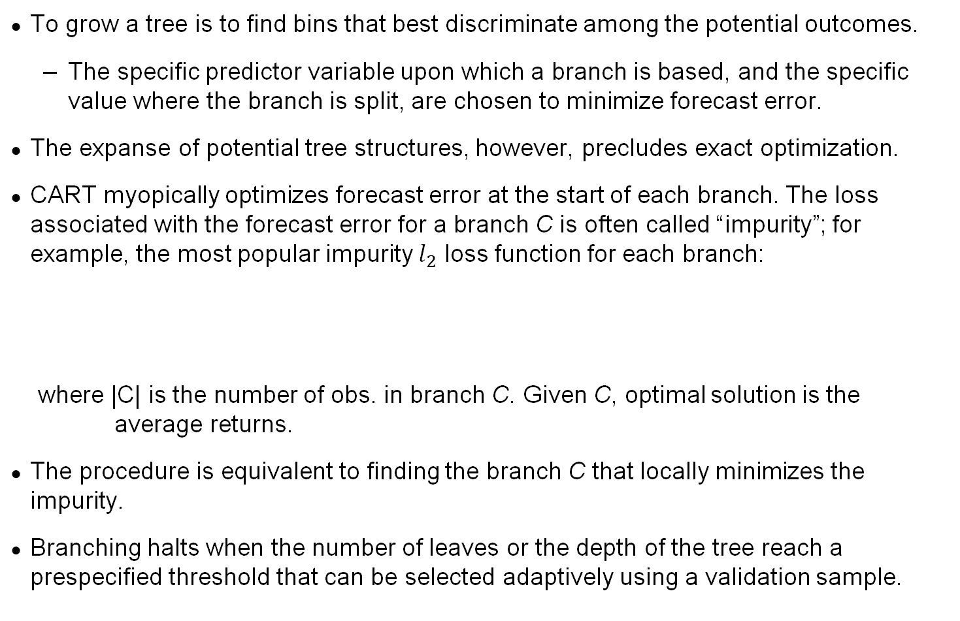
Solving for the tree
To grow a tree is to find bins that best discriminate among the potential outcomes.
The specific predictor variable upon which a branch is based, and the specific value where the branch is split, are chosen to minimize forecast error.
The expanse of potential tree structures, however, precludes exact optimization.
CART myopically optimizes forecast error at the start of each branch. The loss associated with the forecast error for a branch C is often called “impurity”; for example, the most popular impurity $l_{2}$ loss function for each branch:
where |C| is the number of obs. in branch C. Given C, optimal solution is the average returns.
The procedure is equivalent to finding the branch C that locally minimizes the impurity.
Branching halts when the number of leaves or the depth of the tree reach a prespecified threshold that can be selected adaptively using a validation sample.

Slide 12
Tree algorithm

Slide 13
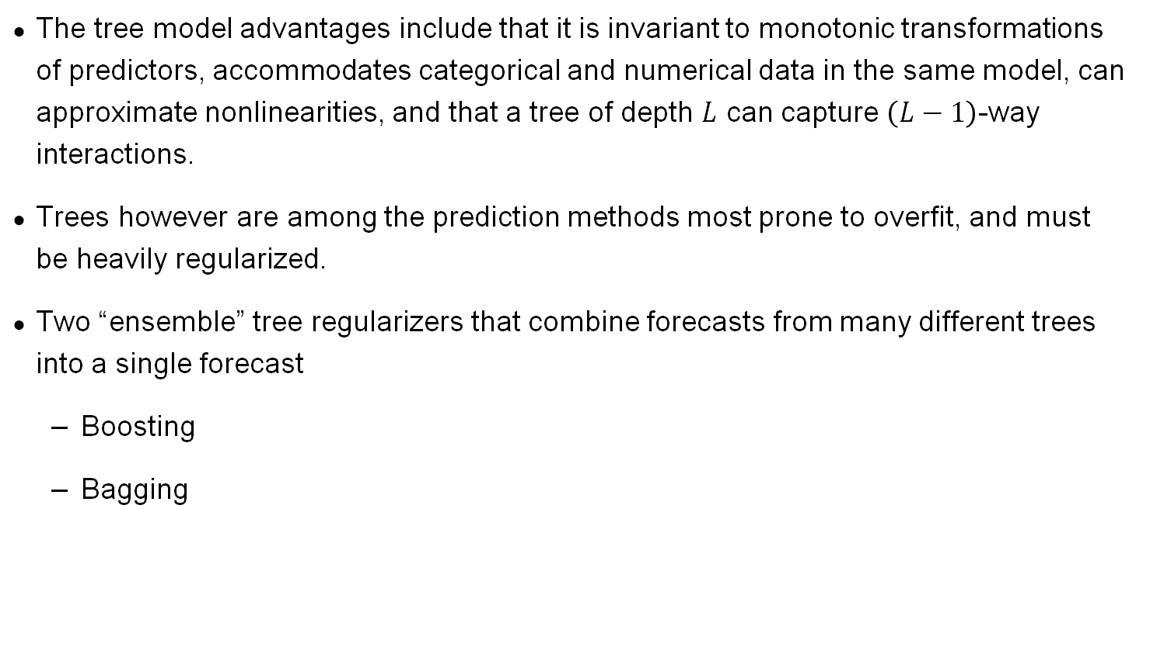
Regression tree pros and cons
The tree model advantages include that it is invariant to monotonic transformations of predictors, accommodates categorical and numerical data in the same model, can approximate nonlinearities, and that a tree of depth $L$ can capture $\left(L−1\right)$-way interactions.
Trees however are among the prediction methods most prone to overfit, and must be heavily regularized.
Two “ensemble” tree regularizers that combine forecasts from many different trees into a single forecast
Boosting
Bagging

Slide 14
Boosting
Shallow trees on their own are “weak learners”—models with small predictive power.
“Boosting” recursively combines forecasts from many oversimplified trees.
The theory behind boosting suggests that many weak learners may, as an ensemble, comprise a single “strong learner” with greater stability than a single complex tree.

Slide 15
Regression Trees- Boosting
Adaptive Boosting (AdaBoost), Friedman et al. (2000)
The AdaBoost algorithm trains first a base classifier and uses it to make predictions on the training set. The algorithm then increases the relative weight of misclassified training instances.
Then it trains a second classifier, using the updated weights, and gain make predictions on the training set, updates the instance weights, and so on.
The algorithm stops when the desired number of predictors is reached, or when a perfect predictor is found.
Cons = high computational cost on large datasets.

Slide 16
Regression Trees- Boosting
Gradient Boosting Decision Trees (GBDT), see Friedman (2001)
Like AdaBoost, GBDT starts with a base tree—usually a shallow tree.
A second simple tree (with the same shallow depth L) is used to fit the prediction residuals from the first tree. Forecasts from these two trees are added together to form an ensemble prediction of the outcome, but the forecast component from the second tree is shrunken by a factor ν ∈(0,1) to help prevent the model from overfitting the residuals.
At each new step b, a shallow tree is fitted to the residuals from the model with b−1 trees, and its residual forecast is added to the total with a shrinkage weight of ν. This is iterated until there are a total of B trees in the ensemble.
Cons = high computational cost on large datasets.

Slide 17
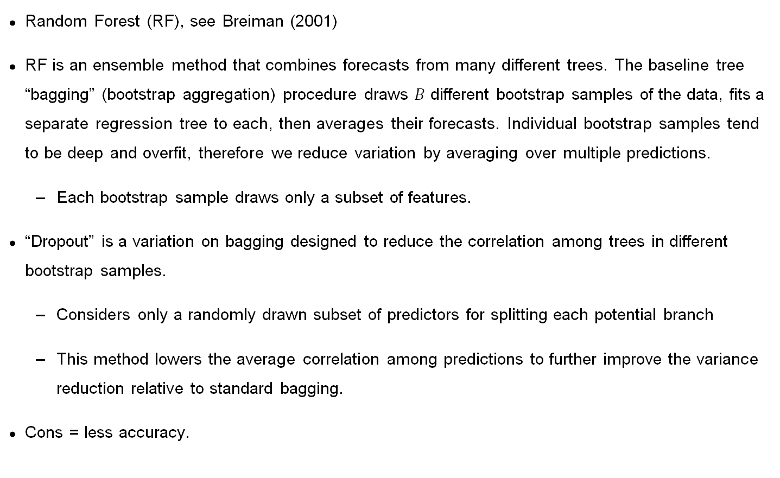
Random Forest and Bagging
Random Forest (RF), see Breiman (2001)
RF is an ensemble method that combines forecasts from many different trees. The baseline tree “bagging” (bootstrap aggregation) procedure draws $B$ different bootstrap samples of the data, fits a separate regression tree to each, then averages their forecasts. Individual bootstrap samples tend to be deep and overfit, therefore we reduce variation by averaging over multiple predictions.
Each bootstrap sample draws only a subset of features.
“Dropout” is a variation on bagging designed to reduce the correlation among trees in different bootstrap samples.
Considers only a randomly drawn subset of predictors for splitting each potential branch
This method lowers the average correlation among predictions to further improve the variance reduction relative to standard bagging.
Cons = less accuracy.

Slide 18
RF algorithm

